Slide 1
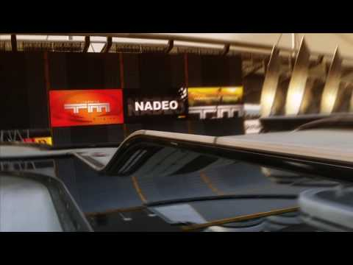
TMCHALLENGER
By:
Kamal Nimmagadda
Mehul Kohli
Ritika Singhal
Rohan Marathe

Slide 2
Technical Difficulties
Instability of the agent during training
Forgetting part of the actions it learned during the second half of the training process
Very high error values - which may cause gradient explosion, leading to erratic changes in Q-values across similar states.

Slide 3
Solutions We Tried
Hyper parameter tuning
Soft update vs Hard update in our double DQN
Tuning the update frequency of the target model
Training on more number of episodes
Gradient Clipping
Removing max pooling layers

Slide 4
Some
Training Results

Slide 5
NEXT STEPS IN TRAINING
Now since the training is stabilized, we can explore the following:
Tuning the reward function and choosing the best one.
Try out different exploration techniques.
Training on more number of episodes.
Tuning of hyperparameters if needed.

Slide 6
A
New
Approach

Slide 7
CNN Classifier
A CNN to classify different actions the user is taking and map it to the most ideal keystroke for the moment.
Used for real time classification on the game env.
Primary focus is to augment it to a CNN based agent to compare the result with the DQN agent.

